Slide 1
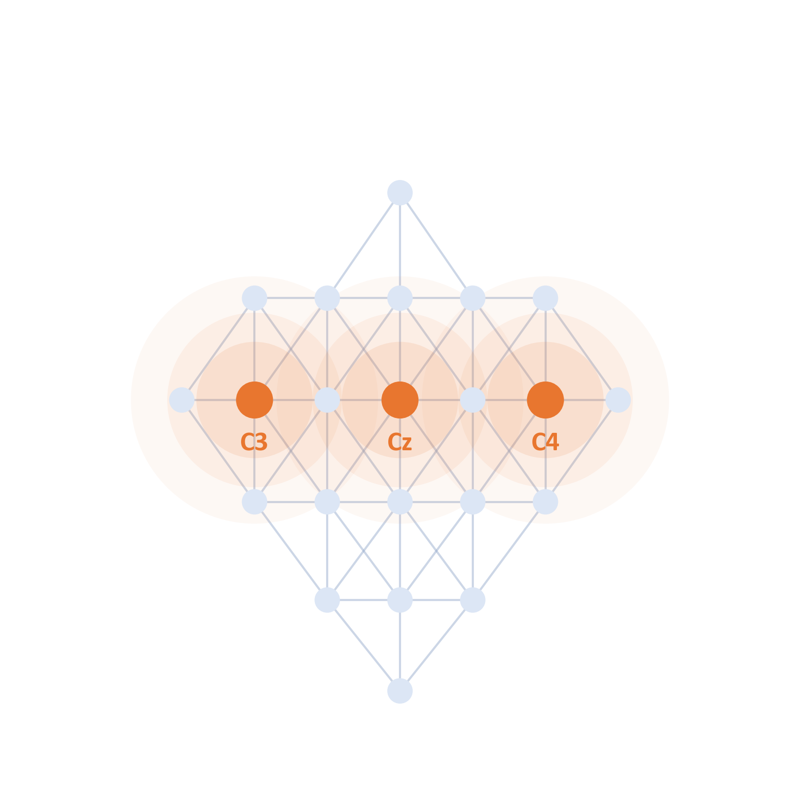
FINAL REVIEW · CSE4006 DEEP LEARNING
Deep Learning–Based Neural Decoder for EEG Motor Imagery
Cross-subject decoding on BCI Competition IV-2a, tested on people the model has never seen
Group 5
Ananya Gourishetty · Haarika D · Siddhanth Samal · Sathvik P
School of Computer Science and Engineering, VIT-AP University · Guide: Dr. Mohan Allam
github.com/sathvikparangi907-web/neural-decoder-eeg-motor-imagery
Notes:
We are Group 5. Our project asks a simple question: can a decoder read imagined movements from the EEG of someone it has never seen, with no calibration session? We will show what we built, the one result that matters, and what we learned about why decoders fail on new people.

Slide 2
Three phases: problem, design, build
RECAP OF THE PHASES
PHASE 1
PHASE 2
PHASE 3
The problem
The design
The build
Every new user needs a calibration session first. We surveyed the published decoders.
HCT-Net designed at 20,996 parameters, with a leave-one-subject-out test plan.
Seven activities built and run. Six decoders compared; the final model has 3,924 parameters.
Objective throughout: decode four imagined movements from the EEG of a person the model has never seen, with no calibration session.
Notes:
A quick recap. Phase 1 defined the problem and surveyed the literature. Phase 2 designed HCT-Net and the test plan. Phase 3, which this review covers, built everything, ran it, and cut the model from 20,996 to 3,924 parameters.

Slide 3
Decoders fail on people they have not seen
PROBLEM STATEMENT
A brain–computer interface turns imagined movement into commands, for people with ALS, spinal-cord injury or stroke.
Today every new user must first record a labelled calibration session.
Goal: a decoder that works for a new person with zero calibration.
−23.88 points
−12.22 points
Notes:
This is the problem. CTNet, a strong recent model, scores 82.52% on four classes when the test person was in training, but 58.64% on someone new: almost 24 points lower. On the two-class dataset the drop is 12 points. The second number is what a real first-time user would get, which is why every user calibrates first today.

Slide 4
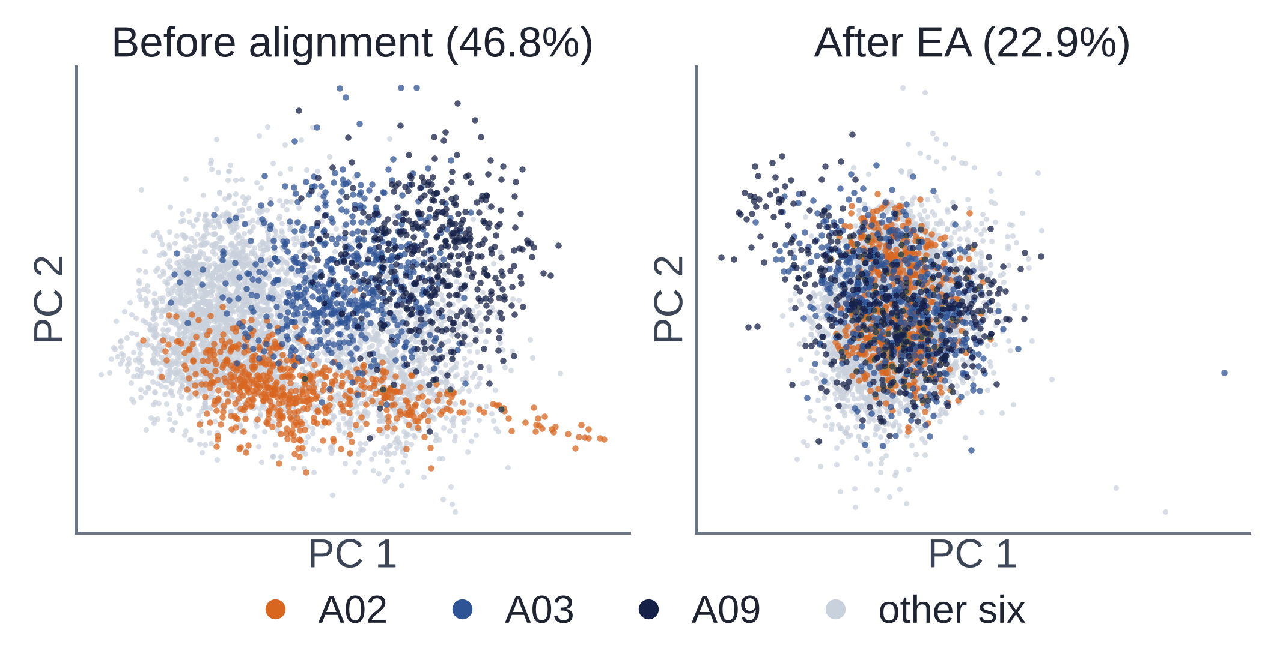
Every person's EEG sits in its own place
WHY UNSEEN PEOPLE ARE DIFFICULT
46.8%
of trials lie closer to their own person's centre than to anyone else's. Chance is 11.1%.
22.9%
after Euclidean alignment of each person's data.
Each dot is one trial. Left: before alignment. Right: after Euclidean alignment [4].
Skull, cortex, cap position and imagery strategy differ, so the signal carries the person as well as the movement.
Notes:
Why is a new person so hard? Each person's EEG carries a strong personal signature. Using only the power of the 22 channels, 46.8% of trials sit closer to their own person's centre than to anyone else's, against 11.1% by chance. Euclidean alignment cuts that to 22.9%. A model trained on seven people meets an eighth whose signals sit somewhere new. (Article, Fig. 6.)

Slide 5
Six objectives, set before the build
OBJECTIVES
1
Pipeline
2
Baselines
3
HCT-Net
A reproducible preprocessing and evaluation pipeline for BCI Competition IV-2a
EEGNet, ATCNet, CTNet and EEG Conformer, with FBCSP as a classical control, under one protocol
Combine EEGNet's convolutional front end with windowed Transformer attention
4
Unseen people
5
Metrics
6
Honest answer
Leave-one-subject-out testing: every number comes from a person the model never saw
Accuracy, Cohen's κ, precision, recall and F1, per person and on average, with model size
State whether the hybrid helps new people while staying small, whichever way it goes
Notes:
These are the six objectives we set in the solution design, before building anything. The last one matters most to us: we committed to reporting whether the hybrid model helps on new people, whichever way the answer went.

Slide 6
What the published models do on a new person
LITERATURE SURVEY
Model | Parameters | Main idea | What HCT-Net takes | New person*
FBCSP + LDA (2008) [11] | — | Hand-designed spatial filters per frequency band, then a linear classifier | Classical control only | not reported
EEGNet (2018) [7] | 3,188 | Compact convolutions: frequency, then spatial, then a summary | The whole convolutional front end | 56.85%
ATCNet (2023) [8] | 113,732 | Attention and temporal convolution inside sliding windows | Attention limited to short windows | not reported
EEG Conformer (2023) [6] | 697,412 | Convolution for local features, a Transformer across the trial | Convolution first, attention after | 53.41%
CTNet (2024) [1] | 152,364 | EEGNet-style front end feeding a six-layer Transformer | The encoder, cut to two layers | 58.64%
* Published leave-one-subject-out accuracy on BCI IV-2a, from the CTNet paper's re-runs under one protocol [1]. Parameters for our 875-sample input.
Gap: size does not predict accuracy on a new person, and two of the five have no published new-person figure.
Notes:
Our literature survey traced the path from hand-designed features to compact convolutional networks and then to attention and Transformers. Two things stood out. Size does not predict accuracy on a new person: EEG Conformer has 219 times as many parameters as EEGNet and is 3.4 points less accurate. And the published numbers come from different protocols, so they cannot be ranked. That is the gap our project fills.

Slide 7
What is new in this project?
OUR NOVELTY
WE TESTED
WHAT WE FOUND
Does a larger network help a new, unseen person?
No reliable benefit from added depth, width or attention
Does reducing the signal difference between people help?
Yes: Euclidean alignment and batch-norm adaptation improved transfer
Can every decision be made without the test labels?
Yes: the validation person and the test person were kept separate
The important factor was reducing person-to-person signal mismatch, not making the network bigger.
Notes:
This is what is new. We did not invent a new layer. We asked three questions under one strict, fair protocol. Does a bigger network help a new person? No. Does reducing the difference between people help? Yes, clearly. Can every decision be made without touching the test labels? Yes, and we did exactly that. The lesson: reduce the mismatch between people, do not grow the model.

Slide 8
Our data: 9 people, 4 imagined movements
DATASET
9
22
4
5,184
people, A01 to A09
EEG electrodes
movements: left hand, right hand, feet, tongue
labelled trials, two days per person
One trial, and the window the decoder sees
Fixation cross
Arrow cue
Imagining the movement
875 samples analysed
0 s
2 s
4 s
6 s
Window: 0.5–4.0 s after the cue, leaving out the response to the arrow itself. Chance is 25%.
Brunner et al. [3]; 250 Hz, two sessions per person on different days.
Notes:
Our data is BCI Competition IV-2a: nine people, 22 electrodes, four imagined movements, 5,184 trials over two days per person. For each trial we analyse 3.5 seconds of imagery, 875 samples, starting half a second after the arrow so the model cannot learn the arrow itself.

Slide 9
Each person is tested once, as a stranger
TRAINING AND EVALUATION
A01
A02
A03
A04
A05
A06
A07
A08
A09
Fold 1
7 people train the model.
1 person validates: it chooses between designs.
1 person is tested once, at the very end.
Early stopping uses a 10% stop-set from the training people, and every setting runs with three seeds.
Fold 2
Fold 3
Fold 4
Fold 5
Fold 6
Fold 7
Fold 8
Fold 9
Train (7 people)
Validation (1)
Test, unseen (1)
Notes:
Leave-one-subject-out. In every fold, seven people train, one validates and one is tested. The validation person only chooses between designs; the test person is scored once at the end and never steers a decision. Early stopping uses a separate 10% stop-set. Every setting runs with three seeds, and a change is kept only if it adds at least 0.75 points on validation.

Slide 10
Nothing about the new person is ever labelled
LABEL-FREE PIPELINE
Once
Every fold
New person
per person, cached
training people only
no labels, no retraining
Keep the 22 EEG channels
Euclidean alignment per session [4]
Align their own unlabelled trials
Band-pass 4–38 Hz
Standardise with training statistics
Re-estimate batch-norm statistics [5]
Cut 0.5–4.0 s after the cue
Augment by recombining same-class segments
Predict the imagined movement
Flag artefacts above 100 µV
Zero calibration: both steps that adapt to a new person use only that person's unlabelled trials.
Notes:
The pipeline has three parts. Once per person: channels, filtering, cutting trials, flagging artefacts. In every fold, on the training people: alignment, standardisation and augmentation. And for a new person, two steps that need no labels at all: align their own unlabelled trials, and re-estimate the batch-norm statistics on them. No label, no gradient step, no retraining.

Slide 11
HCT-Net A: a compact hybrid model
MODEL ARCHITECTURE
Input
Convolution
5 windows
Transformer
Pool + linear
one trial, 3.5 s
EEGNet-style: temporal, spatial, separable
11 steps each, overlapping
1 encoder layer, 2 heads
softmax over the classes
22 × 875
3,924
1
4
input: electrodes × samples
trainable parameters
Transformer encoder layer
classes out
Borrowed building blocks: EEGNet-style convolution [7] feeding a Transformer encoder [9]. The Phase 2 design had 20,996 parameters; a size sweep showed the smallest version did as well.
Notes:
The final model, HCT-Net A. A trial of 22 electrodes by 875 samples goes through an EEGNet-style convolutional front end, is cut into five overlapping windows, passes one small Transformer layer, and is averaged and classified. 3,924 parameters: 1,456 in the convolution, 2,224 in the encoder, 176 for positions and 68 in the head. The Phase 2 design was five times bigger and no better. (Article, Section IV-C and Table XVI.)

Slide 12
53.6% vs 54.3%: a tie, not a win
FINAL RESULT
3,924
parameters in HCT-Net A
κ = 0.381
Cohen's kappa (0 = chance)
chance 25%
9
Difference: 0.7 points
Predefined decision threshold: 0.75 points
Conclusion: a tie, not a claimed win
people, each tested once as a stranger
Notes:
This is our headline. Under the final protocol, mean of three seeds, HCT-Net A scores 53.6% on people it has never seen and EEGNet scores 54.3%. The 0.7-point gap is inside the 0.75-point threshold we fixed before testing, and the 95% interval runs from minus 4.3 to plus 2.9. So we call it a tie, not a win. HCT-Net A has 3,924 parameters and a kappa of 0.381. (Article, Tables XVII and XVIII.)

Slide 13
Alignment helped; extra size did not
WHAT HELPED, WHAT FAILED
Helped
Did not help
Euclidean alignment [4]
5× more parameters (design D)
+9.4 points on EEGNet, 9 of 9 people better
52.7% vs 53.6%: no gain
Batch-norm re-estimation [5]
Attention
+4.3 points on HCT-Net A, 9 of 9 people better
removing it cost nothing (48.8% vs 46.9%, v1)
Batch norm inside the encoder
49.3% vs 53.6% on validation, 9 of 9 worse
Protocol v2, three seeds, unless marked v1 (earlier protocol, one seed). Article Tables X, XI, XIV and XVI–XVIII.
Notes:
What moved results, and what did not. Alignment added 9.4 points to EEGNet and helped all nine people. Re-estimating batch-norm statistics on the new person's unlabelled trials added 4.3 points to HCT-Net A, again for all nine. On the other side: five times more parameters gave nothing, removing attention cost nothing, and batch norm inside the encoder made every person worse.

Slide 14
Per person, accuracy runs from 31% to 77%
PER-PERSON RESULTS
31–77%
A02 lowest, A03 highest
4 of 9
people below 46%: A02, A05, A04, A06
chance
Feet
is the hardest class (appendix A3)
Test accuracy per person, protocol v2 with BN adaptation, mean of three seeds (article Table XXV).
Notes:
The average hides a lot. Per person, accuracy runs from 31% for A02 to 77% for A03, and four of nine people stay below 46%. The same people are hard for every model, and they are the people whose own two recording days differ most. Feet is the hardest movement to recognise. Every person's result is reported in the article.

Slide 15
Three challenges, each solved and measured
CHALLENGES FACED
CHALLENGE 1
CHALLENGE 2
CHALLENGE 3
The validation person flattered itself
One run was not enough
The Phase 2 model transferred worst
Problem
It stopped training and chose designs.
Fix
Early stopping moved to a 10% stop-set.
Result
Validation–test gap: 6.9 → 0.3 points
Problem
Seed noise moved results by about a point.
Fix
Three seeds and a 0.75-point rule.
Result
Two single-run gains failed and were dropped
Problem
46.9%: lowest of the five networks (v1).
Fix
A size sweep and label-free adaptation.
Result
3,924 parameters, 53.6%: level with EEGNet
Notes:
Three problems we hit. First, our validation person both stopped training and chose designs, so it flattered itself; moving early stopping to a separate stop-set closed the gap between validation and test from 6.9 to 0.3 points. Second, one run was too noisy, so every setting got three seeds and a fixed threshold. Third, our Phase 2 design transferred worst of the networks; the size sweep and adaptation brought it level with EEGNet at a fifth of the size.

Slide 16
What this study cannot claim
LIMITATIONS
5.4 points
Nine people is a small sample: differences below about 5.4 points cannot be detected reliably (80% power).
v1 only
ATCNet, CTNet and EEG Conformer have one-seed results under the earlier protocol; they were not re-run under v2.
53.6%
is not ready for daily use: four people stay below 46%, and a familiar person scores 18.5 points higher.
Notes:
Three honest limits. With nine people we can only detect differences above about 5.4 points, so small differences between models are out of reach. The three large baselines were run only under our earlier protocol, with one seed. And 53.6% is far from a usable product: four people stay below 46%, and the same model scores 18.5 points higher on a familiar person.

Slide 17
Not size, but alignment and adaptation
CONCLUSION AND FUTURE SCOPE
Conclusions
Future scope
HCT-Net A, 3,924 parameters: 53.6% on unseen people, a tie with EEGNet
Alignment (+9.4) and label-free adaptation (+4.3) moved results most
Above 3,924 parameters, extra size bought nothing
Adapt online as a new user's trials arrive
Pre-train on PhysioNet MI (109 people), then adapt
Re-run every baseline under the final protocol
Contribution: the building blocks are borrowed; what is new is the measurement: six decoders in one fair pipeline, a strict selection protocol, and evidence that the cross-subject gap is not a capacity problem.
Notes:
To conclude: our compact model ties EEGNet on people it has never seen. What moved results was reducing the difference between people: alignment and label-free adaptation. Extra size bought nothing. Next we would adapt online as a user's trials arrive, pre-train on larger datasets, and re-run every baseline under the final protocol.

Slide 18
Bigger models were not the answer.
Better subject alignment was.
Thank you. Questions are welcome.
Group 5 · Ananya Gourishetty, Haarika D, Siddhanth Samal, Sathvik P
Notes:
If you remember one thing: bigger models were not the answer; better alignment between people was. Thank you. The appendix has the full baseline table, the confusion matrices and our references for questions.

Slide 19
All seven Phase 3 activities are complete
APPENDIX A1
01
02
03
04
05
06
07
Setup & data
Preprocessing & EDA
Five baselines
HCT-Net
Training & tuning
Experiments
Evaluation
6.9 → 0.3
+4.3
points between validation and test once early stopping got its own stop-set
test points from label-free adaptation (49.3% → 53.6%); all nine people improve
20,996 → 3,924
6 decoders
parameters after the size sweep, with accuracy level or better
compared in one pipeline, every published figure traced to its source
Notes:
For questions about scope: all seven activities are complete and in the repository.

Slide 20
Every model, with its protocol
APPENDIX A2
Model | Parameters | Protocol | Test accuracy | κ
Final protocol v2: three seeds, BN adaptation
HCT-Net A (ours) | 3,924 | v2 | 53.6 ± 15.6 | 0.381
EEGNet [7] | 3,188 | v2 | 54.3 ± 17.0 | 0.391
HCT-Net D (Phase 2 design) | 20,996 | v2 | 52.7 ± 15.3 | 0.369
TS-LR + re-centring, classical | — | deterministic | 50.5 ± 15.4 | 0.340
Earlier protocol v1: one seed, no adaptation (not re-run under v2)
ATCNet [8] | 113,732 | v1 | 52.4 ± 17.5 | 0.365
EEG Conformer [6] | 697,412 | v1 | 52.1 ± 14.6 | 0.362
EEGNet [7] | 3,188 | v1 | 51.2 ± 17.0 | 0.349
CTNet [1] | 152,364 | v1 | 50.2 ± 13.6 | 0.336
HCT-Net D | 20,996 | v1 | 46.9 ± 17.5 | 0.292
FBCSP + LDA [11] | — | v1 | 44.2 ± 13.0 | 0.256
Test accuracy on unseen people, mean ± SD across the nine test people. v1 and v2 numbers are not a single ranking. Article Tables VIII and XVII.
Notes:
The full comparison, with protocols kept apart. Only the top block is directly comparable with our final model.

Slide 21
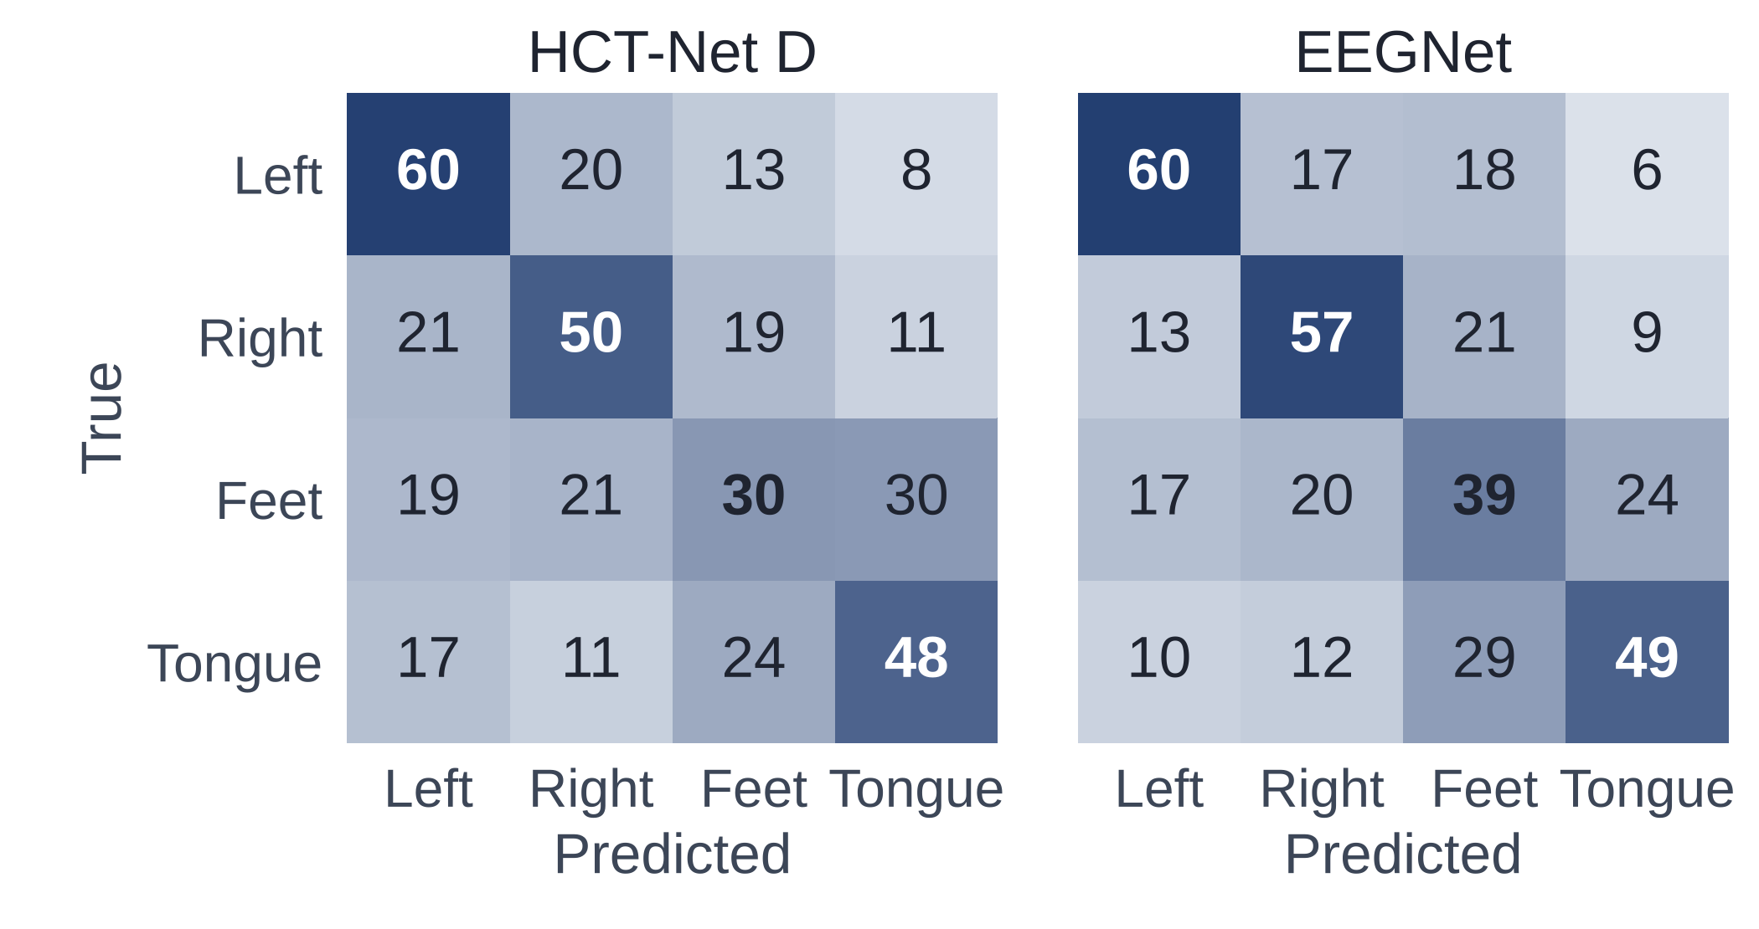
Feet is the hardest class to recognise
APPENDIX A3
Feet is recognised only 30% (HCT-Net D) and 39% (EEGNet) of the time.
Its errors go mostly to tongue: both sit near the middle of the head.
Left and right hand are recognised best.
Percent of each true class, pooled over the nine test folds, protocol v1, one seed (article Fig. 19).
Notes:
Per class, feet is the weakest: recognised about a third of the time and mostly confused with tongue.

Slide 22
Sources cited in this presentation
REFERENCES
[1] W. Zhao et al., “CTNet: a convolutional transformer network for EEG-based motor imagery classification,” Sci. Rep., 2024.
[2] M. Tangermann et al., “Review of the BCI Competition IV,” Front. Neurosci., 2012.
[3] C. Brunner et al., “BCI Competition 2008 – Graz data set A,” Graz Univ. Technol., 2008.
[4] H. He and D. Wu, “Transfer learning for brain–computer interfaces: a Euclidean space data alignment approach,” IEEE Trans. Biomed. Eng., 2020.
[5] Y. Li et al., “Revisiting batch normalization for practical domain adaptation,” arXiv:1603.04779, 2016.
[6] Y. Song et al., “EEG Conformer: convolutional transformer for EEG decoding and visualization,” IEEE TNSRE, 2023.
[7] V. J. Lawhern et al., “EEGNet: a compact convolutional neural network for EEG-based BCIs,” J. Neural Eng., 2018.
[8] H. Altaheri et al., “Physics-informed attention temporal convolutional network for EEG-based motor imagery classification,” IEEE TII, 2023.
[9] A. Vaswani et al., “Attention is all you need,” NeurIPS, 2017.
[10] R. T. Schirrmeister et al., “Deep learning with convolutional neural networks for EEG decoding and visualization,” Hum. Brain Mapp., 2017.
[11] K. K. Ang et al., “Filter bank common spatial pattern (FBCSP) in brain–computer interface,” Proc. IJCNN, 2008.
Notes:
Full references with volumes and pages are in the article.

